Slide 1

IETF na América Latina
IPv6 en el IETF
Alvaro Retana (aretana@cisco.com)
Distinguished Engineer, Cisco Services
Routing Area Director, IETF

Slide 2

“The mission of the IETF is to produce high quality, relevant technical and engineering documents that influence the way people design, use, and manage the Internet in such a way as to make the Internet work better. These documents include protocol standards, best current practices, and informational documents of various kinds.“
RFC 3935
A Mission Statement for the IETF

Slide 3
IPv6 IETF Timeline
ipng WG
(1994)
Internet Protocol, Version 6 (IPv6) Specification
(rfc1883 / 1995)
ipv6 WG (2000)
IPv6 as Draft Standard (rfc2460 / 1998)
6man WG (2007)
v6ops WG (2002)

Slide 4
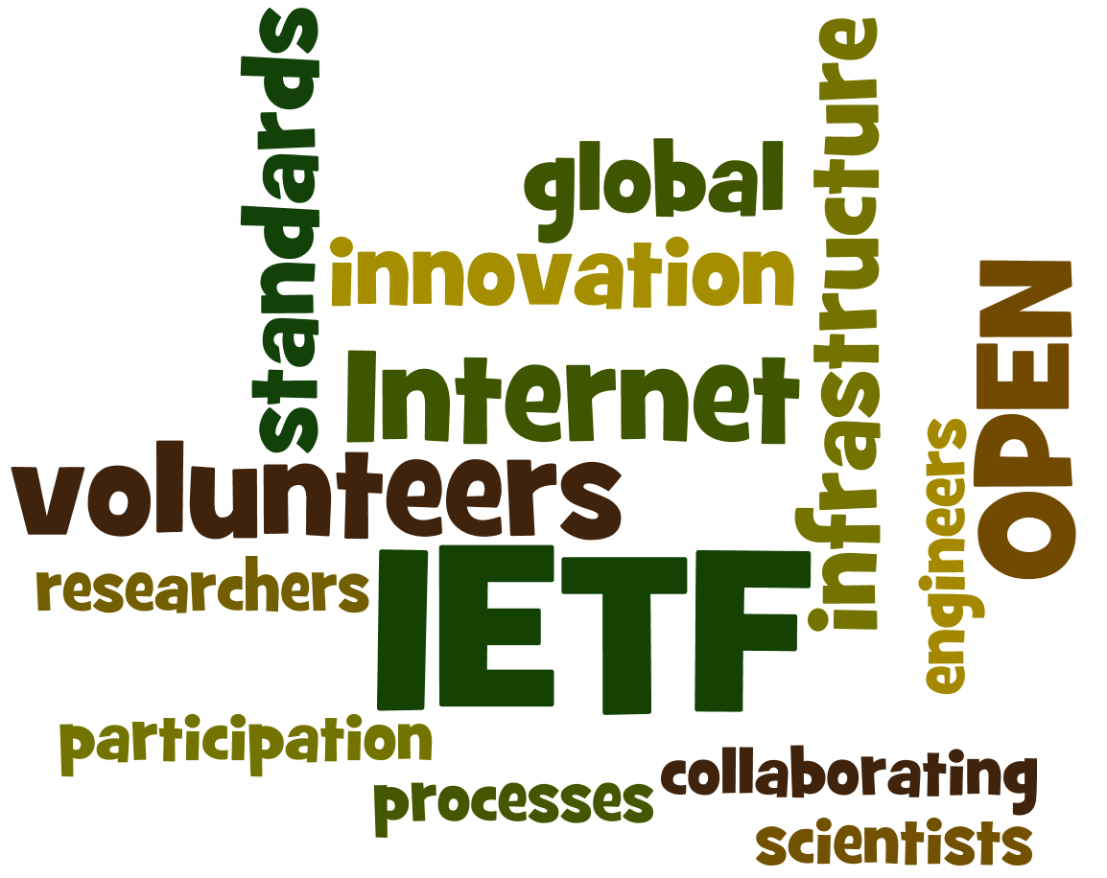
  No one is in charge, anyone can contribute and everyone can benefit.

Slide 5
IETF Organization: Areas
General Area (gen)
Security (sec)
...activities focused on supporting, updating and maintaining the IETF standards development process.
...IP layer (both IPv4 and IPv6), DNS, mobility, VPNs and pseudowires..., and various link layer technologies.
Operations & Management (ops)
Network Management, AAA, and various operational issues facing the Internet such as DNS, IPv6, operational security and Routing operations.
Transport Services (tsv)
...focused on security protocols...services: integrity, authentication, non-repudiation, confidentiality, and access control...key management is also vital.
Applications and Real Time (art)
...responsible for ensuring continuous operation of the Internet routing system...
Internet (int)
...works on mechanisms related to end-to-end data transport...
Routing (rtg)
Protocols for delay-sensitive communications, and building blocks to be used across a wide variety of applications.

Slide 6
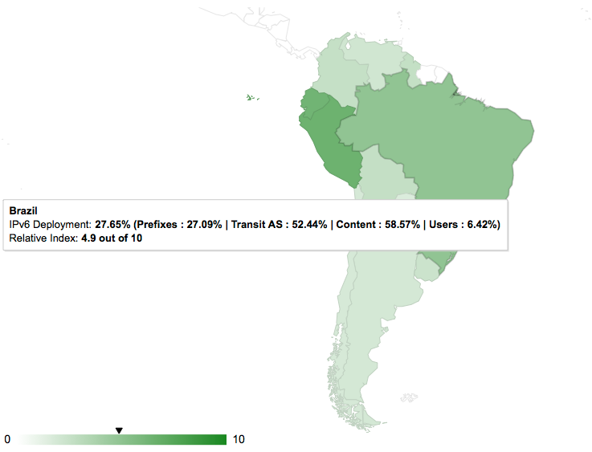
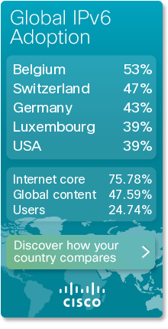
IPv6 Deployment
http://6lab.cisco.com

Slide 7
IPv6 Maintenance (6man)
…responsible for the maintenance, upkeep, and advancement of the IPv6 protocol specifications and addressing architecture…
Recent RFCs
  RFC 7346 IPv6 Multicast Address Scopes
  RFC 7371 Updates to the IPv6 Multicast Addressing Architecture
  RFC 7421 Analysis of the 64-bit Boundary in IPv6 Addressing
  RFC 7527 Enhanced Duplicate Address Detection
  RFC 7559 Packet-Loss Resiliency for Router Solicitations

Slide 8
IPv6 Maintenance (6man) (2)
Current Work
  Recommendation on Stable IPv6 Interface Identifiers (draft-ietf-6man-default-iids)
  Deprecating the Generation of IPv6 Atomic Fragments (draft-ietf-6man-deprecate-atomfrag-generation)
  Privacy Considerations for IPv6 Address Generation Mechanisms (draft-ietf-6man-ipv6-address-generation-privacy)
  Routing packets from hosts in a multi-prefix network (draft-ietf-6man-multi-homed-host)
  Security Implications of Predictable Fragment Identification Values (draft-ietf-6man-predictable-fragment-id)
  IPv6 Router Advertisement Options for DNS Configuration (draft-ietf-6man-rdnss-rfc6106bis)
  Internet Protocol, Version 6 (IPv6) Specification (draft-ietf-6man-rfc2460bis)
  IPv6 Neighbor Discovery Optional RS/RA Refresh (draft-ietf-6man-rs-refresh)

Slide 9
Home Networking (homenet)
...focuses on the evolving networking technology within and among relatively small "residential home" networks.
General Routing Requirements:
  knowledge of the homenet topology
  inclusion of the PHY layer characteristics in path computation
  Multi-homing
  self-configuring
Reading List
  IPv6 Home Networking Architecture Principles (rfc7368)

Slide 10
IPv6-Related Working Groups
Internet Area
  ...IP layer (both IPv4 and IPv6), implications of IPv4 address depletion, co-existence between the IP versions..., and various link layer technologies.
  IPv6 over Networks of Resource-constrained Nodes (6lo)
  IPv6 over the TSCH mode of IEEE 802.15.4e (6tisch)
Routing Area
  Routing Over Low power and Lossy networks (roll)
  Source Packet Routing in Networking (spring)

Slide 11
Softwires (softwire)
... standardization of discovery, control and encapsulation methods for connecting IPv4 networks across IPv6 networks and IPv6 networks across IPv4 networks...
Recent RFCs
  RFC 6908 Deployment Considerations for Dual-Stack Lite
  RFC 7596 Lightweight 4over6: An Extension to the Dual-Stack Lite Architecture
  RFC 7597 Mapping of Address and Port with Encapsulation (MAP-E)
  RFC 7599 Mapping of Address and Port using Translation (MAP-T)
  RFC 7600 IPv4 Residual Deployment via IPv6 - A Stateless Solution (4rd)
Current Work
  Delivery of IPv4 Multicast Services to IPv4 Clients over an IPv6 Multicast Network (draft-ietf-softwire-dslite-multicast)
  Mapping of Address and Port (MAP) - Deployment Considerations (draft-ietf-softwire-map-deployment)
  Softwire Mesh Multicast (draft-ietf-softwire-mesh-multicast)

Slide 12
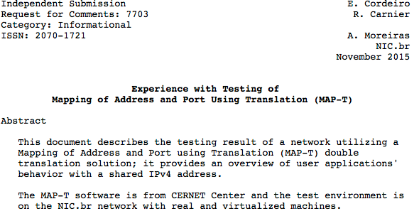
Caso de Sucesso Brasileiro
O trabalho inicial foi apresentada no I Workshop pré IETF (Brasilia 2014).
Parabéns Edwin Rodrigo e Antonio!

Slide 13
IPv6 Operations (v6ops)
... main focus of the v6ops WG is to look at the immediate deployment issues…
Recent RFCs
  RFC 7269 NAT64 Deployment Options and Experience
  RFC 7335 IPv4 Service Continuity Prefix
  RFC 7381 Enterprise IPv6 Deployment Guidelines
  RFC 7445 Analysis of Failure Cases in IPv6 Roaming Scenarios
  RFC 7526 Deprecating the Anycast Prefix for 6to4 Relay Routers
  RFC 7608 IPv6 Prefix Length Recommendation for Forwarding

Slide 14
IPv6 Operations (v6ops) (2)
Current Work
  Some Design Choices for IPv6 Networks (draft-ietf-v6ops-design-choices)
  DHCPv6/SLAAC Interaction Problems on Address and DNS Configuration (draft-ietf-v6ops-dhcpv6-slaac-problem)
  Host address availability recommendations (draft-ietf-v6ops-host-addr-availability)
  Reducing energy consumption of Router Advertisements (draft-ietf-v6ops-reducing-ra-energy-consumption)
  SIIT-DC: Stateless IP/ICMP Translation for IPv6 Data Centre Environments (draft-ietf-v6ops-siit-dc)
  SIIT-DC: Dual Translation Mode (draft-ietf-v6ops-siit-dc-2xlat)
  Explicit Address Mappings for Stateless IP/ICMP Translation (draft-ietf-v6ops-siit-eam)
  Unique IPv6 Prefix Per Host (draft-ietf-v6ops-unique-ipv6-prefix-per-host)

Slide 15
Sunsetting IPv4 (sunset4)
...point out specific areas of concern, provide recommendations, and standardize protocols that facilitate the graceful "sunsetting” of the IPv4 Internet in areas where IPv6 has been deployed. This includes the act of shutting down IPv4 itself...
Current Work
  Gap Analysis for IPv4 Sunset (draft-ietf-sunset4-gapanalysis)
  Turning off IPv4 Using DHCPv6 or Router Advertisements (draft-ietf-sunset4-noipv4)

Slide 16

Cómo Participar en el IETF?

Slide 17
How to Participate in the IETF?
Monitor
Authorship
Meeting Attendance
List Participation
Leadership Position
Join a mailing list..
..start contributing!!

Slide 18
Standards Process
Internet Drafts (ID)
Discussion in a WG
WG sends IESG request to publish an ID ‘when ready’
AD review
2-week IETF-wide Last-Call
IESG review
Publication as RFC

Slide 19
IETF Meetings
Recent Meetings
92nd IETF
  March 22-27, 2015
  Dallas, TX, USA
93rd IETF
  July 19-24, 2015
  Prague, Czech Republic
94th IETF
  November 1-6, 2015
  Yokohama, Japan
Upcoming Meetings
95th IETF
  April 3-8, 2016
  Buenos Aires, Argentina
96th IETF
  July 17-22, 2016
  Berlin, Germany
97thh IETF
  November 13-18, 2016
  Seoul, South Korea

Slide 20
IETF LAC Task Force
LACNOG creó el Grupo de Trabajo IETF LAC en Mayo del 2013 con el objetivo de fomentar la participación de personas de la región en las discusiones y procesos del IETF.
Algunas de las metas son:
  Ser un mecanismo para introducir nuevas personas en el IETF
  Facilitar la discusión de ideas en el idioma local (Español, Portugués, Inglés)
  Proveer un lugar en el cual los autores latinos puedan compartir sus drafts y recibir comentarios de sus colegas
    http://mail.lacnic.net/mailman/listinfo/ietf-lac

Slide 21

Actividades y Enfoque Local
ietf-lac@lacnog.org
Pre-IETF
  Eventos Virtuales antes de cada reunión del IETF.
  Conferencias Locales y Regionales
Educación y Evangelización
Publicación de Documentos

Slide 22
Participación Remota
Idea: "hub remoto" de participación
  grupo de personas locales con intereses comunes
  sin tener que viajar a la reunión
Experiencia:
  IETF 91 (Honolulu): 1 WG, 7 hubs, 50 personas
  IETF 92 (Dallas): 10+ WGs, 15+ hubs, ~100 personas
  IETF 93 (Praga): 15+ WGs, 20+ hubs, ~200 personas

Slide 23

Llamado a Acción
Aumentemos la Participación Local en el IETF!
  Creación de Grupos de Interés Común
  Discusiones de Temas Importantes
  Participación en las Listas de Correo
  Participación en Reuniones de Grupos de Trabajo
  Patrocinio para la Asistencia a Reuniones del IETF
  Educación y Evangelización

